Slide 1
Investigation of High Shear Granulation Particle Distribution
Michael Lay
Dr. Heather Emady
Arizona Space Grant Symposium, April 14th 2018

Slide 2
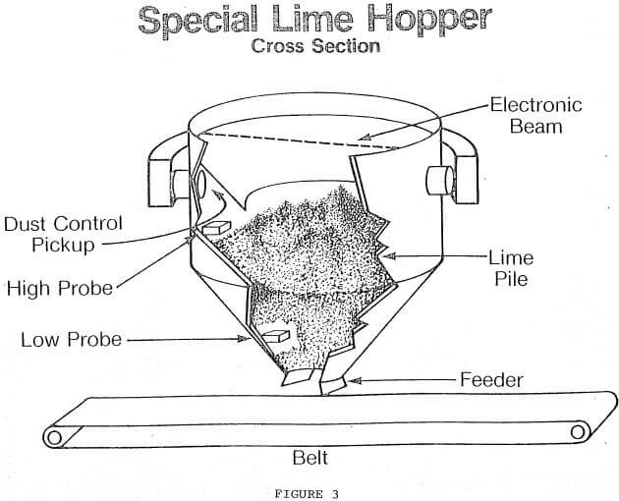
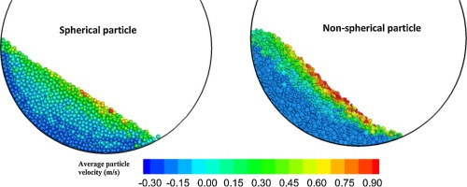
Introduction: Particle Technology
Characterization, handling, and processing of solids unlike fluids
Behavior affected by: friction, density, porosity, structure
Highly empirical field, conducive to research in fundamental phenomena
Example equipment: hoppers, drums, granulators
https://www.911metallurgist.com/blog/lime-slaking-system
https://www.sciencedirect.com/science/article/pii/S0263876215002154

Slide 3
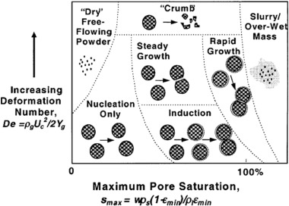
Introduction: High Shear Granulation
Process of adding liquid binder to powder to create larger granules
Industries: pharmaceuticals, cosmetics, food production, detergent
Studies highlight different regimes, further understanding of processing effects required.
L/S Ratio
Impeller Speed
Drop Height / Impact
Wet-massing time
This graph I stol from Manogna’s paper, need to include citation for it.

Slide 4
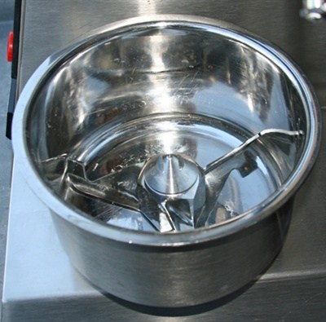
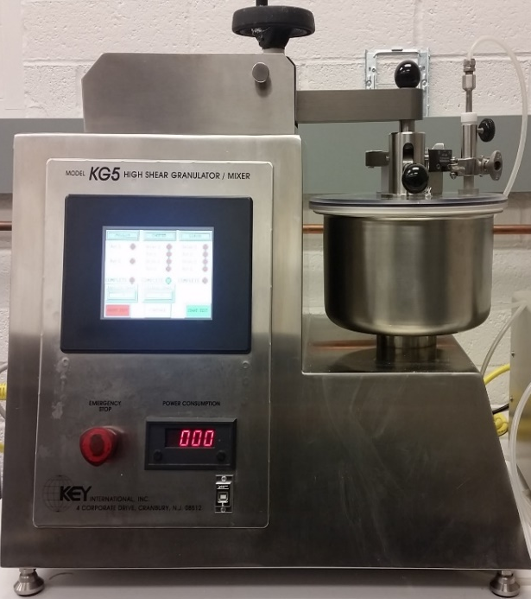
Experimental: Set-up
Objective: Maximize particles near 1 mm in diameter
Water added to Microcrystalline Cellulose (MCC)
Closely mimic single drop test, slow impellor, low liquid flowrate
Four Liquid/solid ratios, two drop heights
5 minute dry mix, 10 mL/min water addition, 1 hour wetmassing
15 minute samples, sieve analysis

Slide 5
Results: During Wetmassing
Weight % of 1 mm particles mm particles formed over time
Ideal L/S ratio near 110-120%
L/S above 130% leads to much larger granules
L/S below 100% lacks sufficient water to make large granules
Increasing drop height has greater effect at lower L/S ratios

Slide 6
Results: After 60 Minutes
Increased drop height lowered mean particle size for 100% and 110%
Increased drop height had practically no effect on particle distribution for 120% and 130% for particles below 1 mm.
L/S ratio of 120% had largest normalized percentage of particles near 1 mm.
L/S below 100% lacks sufficient water to make large granules
More than 50% of granules formed were larger than 1 mm for L/S ratios of 120% and 130%

Slide 7
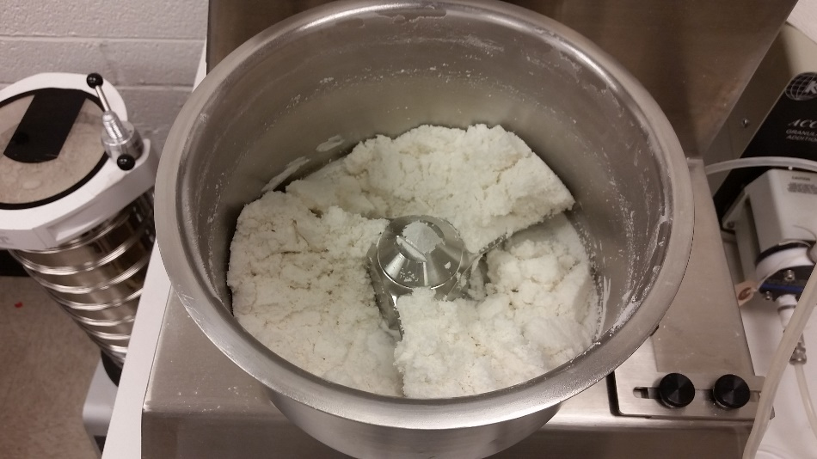
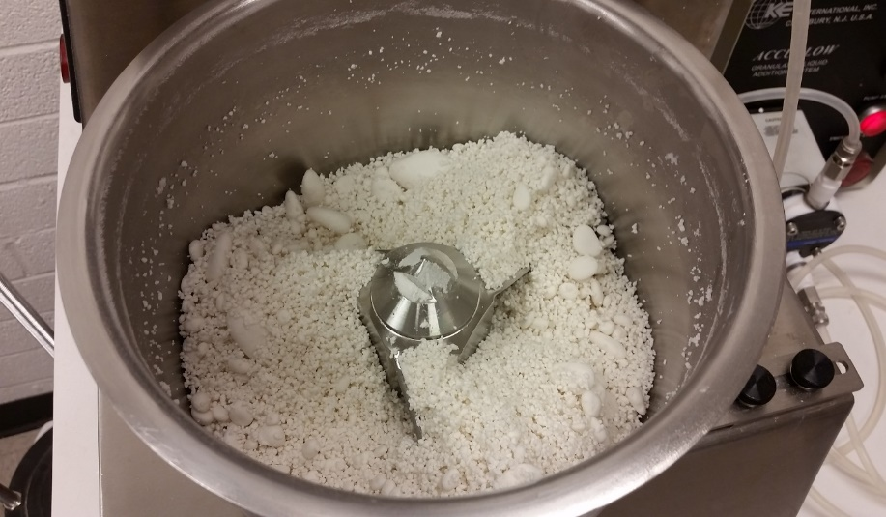
Conclusions: This Investigation
An L/S ratio between 110% to 120% will maximize the normalized percentage of 1 mm granules, but the distribution is broad
Increasing drop height could narrow distribution since greater impact leads to great penetration by the liquid
Drop height has a minimal effect on initial nucleation, and even less effect on final granulation formation

Slide 8
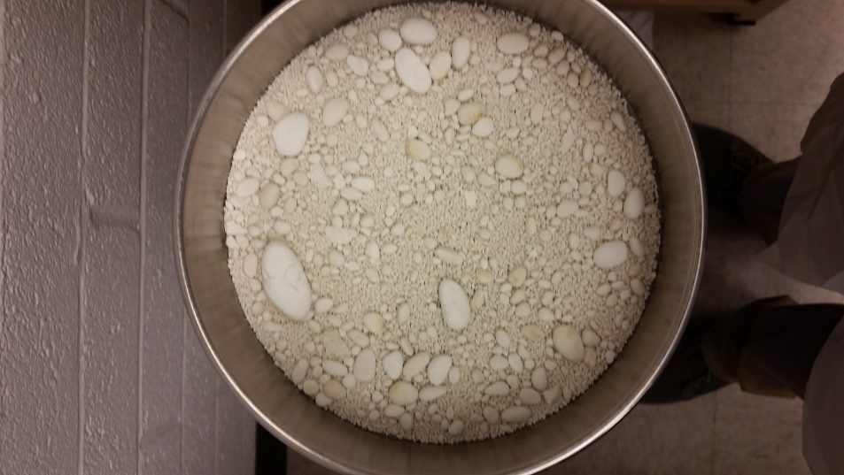
Conclusions: Future Investigations
Future goal: narrowing size distribution of granules
Investigate size distributions of larger granules e.g. L/S ratio of 130%
Alter impellor speed to verify literature and identify regime type
Further characterize process equipment and solid properties to improve comprehension of underlying phenomena
Ultimate Goal: create model that predicts size and distribution of formed granule

Slide 9
Acknowledgements
NASA Space Grant
ASU undergraduate research opportunities
Dr. Heather Emady
Manogna Adepu & Tianxiang Gao
Desiree Crawl & Stephanee Germaine

Slide 10
Thank you
Questions?

